Slide 1
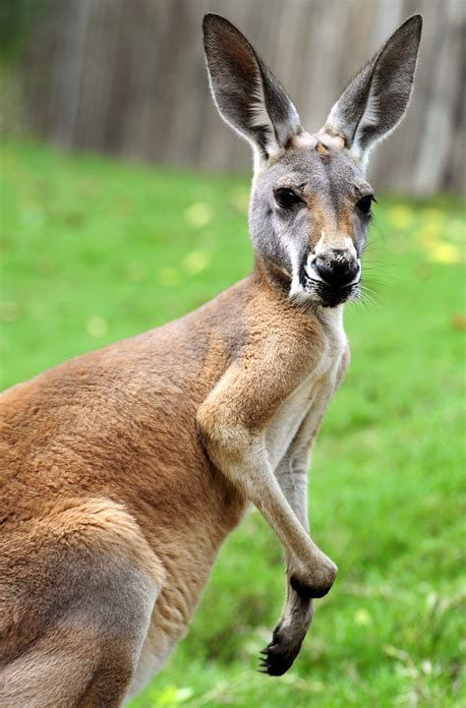
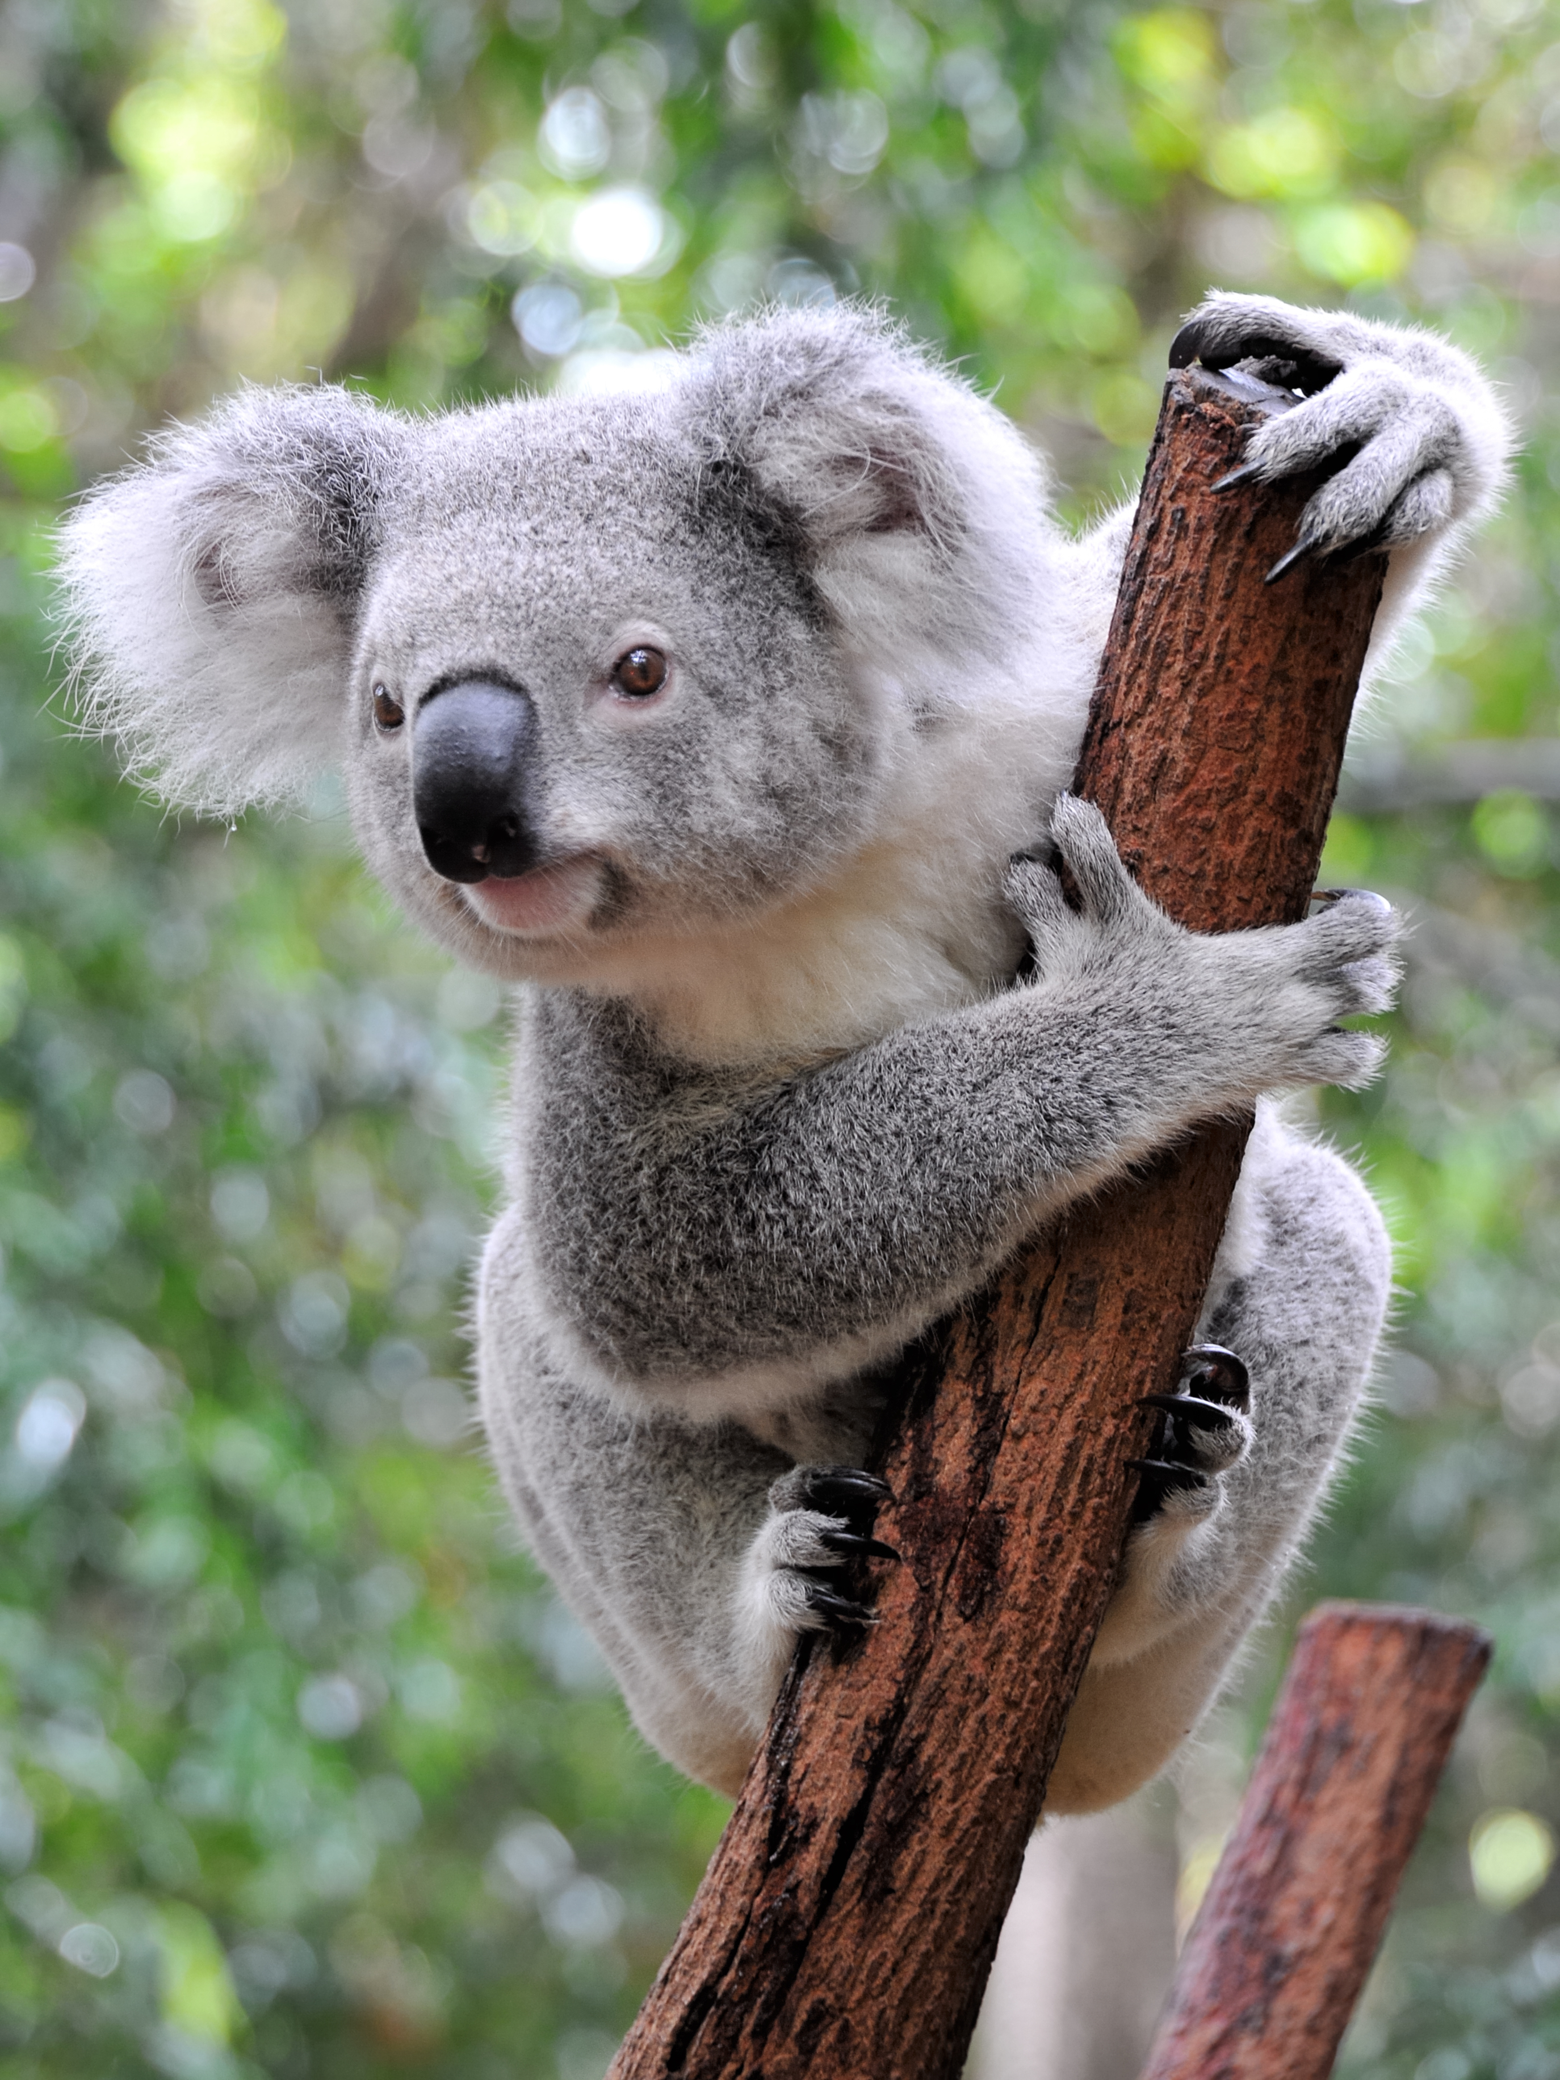
Observable Characteristics – Page 1
In the following passage, underline or highlight all the key-words and information. Then, answer the questions on the back
Observable characteristics are traits that we can see or identify just by looking at an animal. These can include things like size, color, patterns, and the presence of certain body parts. By observing these characteristics, we can learn a lot about different animals and how they live. In this worksheet, we'll explore the observable characteristics of two common animals: kangaroos and koalas.
Kangaroos are large marsupials that are easily recognizable. An adult kangaroo can stand between 0.6 to 2 meters tall. They are most known for their powerful hind legs, which are designed for hopping and leaping at high speeds across the Australian landscape. Their color varies from a light grey to a reddish-brown, depending on the specific species. Kangaroos also have a long, muscular tail that acts as a balance while they are moving or standing upright. Their small forelimbs, in contrast to their large hind legs, are used for feeding and grooming. These observable traits hint at the kangaroo's lifestyle, which involves fast movement to escape predators and grazing on vegetation.
Koalas, another type of marsupial found in Australia, have quite different observable characteristics compared to kangaroos. They are much smaller, with a body length of about 60-85 cm. Their fur is thick and grey with white patches on their chest and inner limbs. This fur not only protects them from extreme temperatures but also provides a sort of camouflage in the eucalyptus trees where they spend most of their time. The koala's large, round ears and distinctive black nose give it a unique appearance. However, their most notable characteristic may be their strong, curved claws. These claws are not used for hunting or defense, like some other animals, but for gripping branches and climbing trees. This indicates the koala's tree-dwelling lifestyle and its diet, which consists mainly of eucalyptus leaves.
Understanding an animal's observable characteristics can give us important information about its lifestyle and behavior. By studying these traits, we can better appreciate the diversity of life on Earth and learn how different species have adapted to their environments.

Slide 2
Observable Characteristics – Page 2
What are observable characteristics?
______________________________________________________________________
What are two features of a kangaroo? (e.g., size, colour, does it have fur, a tail)
_____________________________________________
_____________________________________________
Describe the purpose of a kangaroo’s long tail.
______________________________________________________________________
What do kangaroos use their small forelimbs for?
______________________________________________________________________
What are two features of a koala? (e.g., size, colour, does it have fur, a tail)
_____________________________________________
_____________________________________________
Why are the koala’s strong, curved claws important for its lifestyle?
______________________________________________________________________
Describe the importance of the koala’s fur.
______________________________________________________________________
Choose any animal, and write down three of its features.
Animal: ___________________________________
_________________________________________
_________________________________________
_________________________________________

